Slide 1
MINI PROJECT
Team members : SUTHARSAN G S
ABDUL RAHIM R
PRAVEEN M
TOPIC : GREEN HOUSE MONITORING SYSTEM
DOMAIN : IOT

Slide 2
OBJECTIVE
To develop a greenhouse monitoring system using IoT
Which monitors greenhouse factors such as humidity, temperature and soil moisture.

Slide 3
SCOPE AND AREA OF THE PROJECT
The proposed system has a measurement which capable of detecting the levels of temperature, humidity and soil moisture. This system also has a mechanism to alert farmers regarding the parameter changes in the greenhouse so that early precaution steps can be taken

Slide 4
Abstract
Greenhouse are climate controlled structures with walls and roof specially designed for offseason growing of plants. Most greenhouse system use manual system monitoring the temperature and humidity which can discomfort to the workers as they are bound to visit the greenhouse everyday and manually control them.
Also a lot of problems can occur as if affects the production rate because the temperature and humidity must be constantly monitored to ensure the good yield of the plants. Internet of things is one of the latest advantages in information and communications technologies, providing global connectivity and management of sensors, devices, user with information

Slide 5
So the combination of iot and embedded system has helped in bringing solutions to many of the existing practical problems over the years.
The sensors used here are REES52 (Soil moisture hydrometer) and DHT11 (Temperature & Humidity sensor).

Slide 6
Introduction
Sudden changes in weather are not favorable for agriculture. Unpredicted rain can destroy the crops. Or less rain can dry off the crops. High temperatures are not good for crops. Some crops even require specific amount of light. Less amount of light can affect the proper growth of the crops. Such situations can be difficult for farmers. This system is developed to ease the work of farmers. The farmer need not run behind all these things. All the data of the sensors will be transmitted to the farmer’s mobile. Due to this system, requirement of manpower is reduced. This system will help farmers for plantation on large scale with less number of labors. The soil moisture sensor is a sensor which varies the value when it contacts the moisture. basically it is a resistor that works on moisture condition. when the moisture is more then the value of resistance will decrease and when the moisture is less then the resistance value is more. Whenever we go out of town for few days, we always used to worry about our plants as they need water on regular basis. This system automatically provides water to your plants and keep you updated by sending message to your cell phone. This is a Completely Automated System and there is no need of manpower to control the system. NodeMCU is used for controlling the whole process and a telegram bot is used for sending alert messages to user on his Cell phone

Slide 7
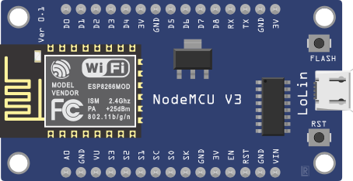
components
This system is controlled by a NodeMCU which has embedded wi-fi module in it . DHT11 is the temperature and humidity sensor which monitors the temperature and humidity of the whole greenhouse.

Slide 8
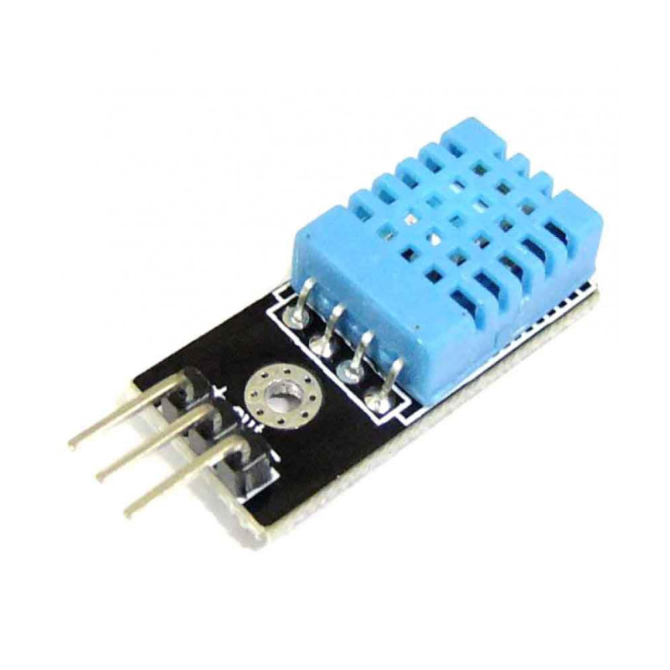
DHT11 sensor

Slide 9
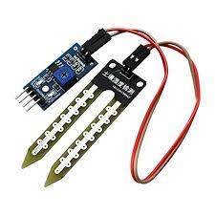
Soil moisture sensor (REES52)
Use to monitor the soil moisture and sends the soil moisture in percentage.

Slide 10
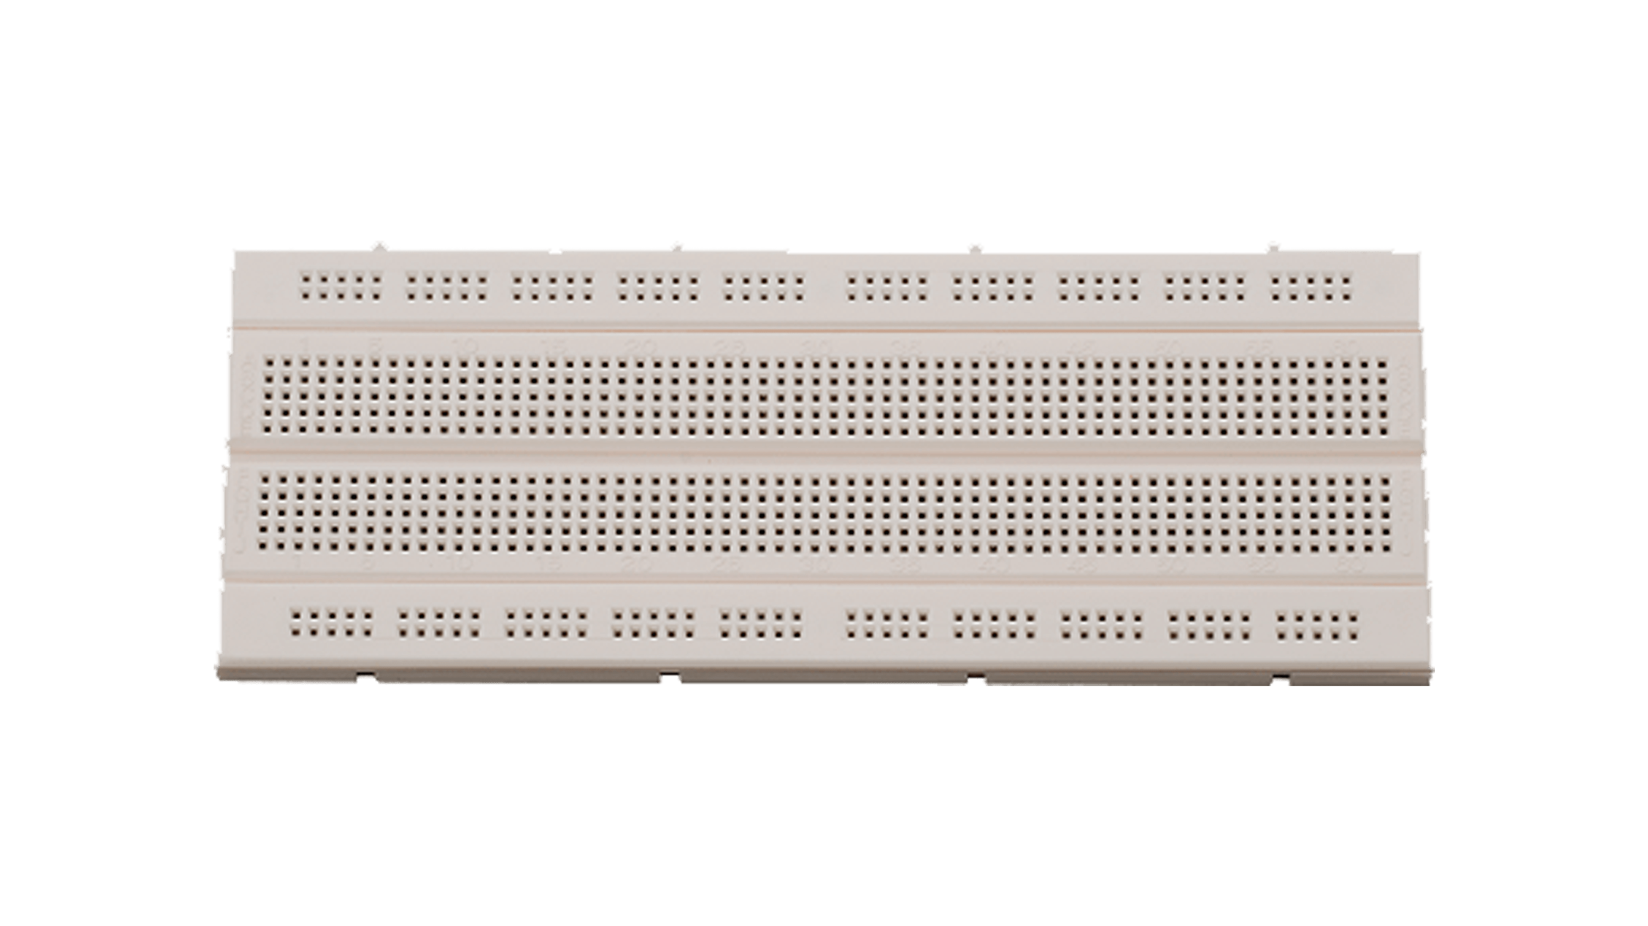
The sensor and the nodeMCU is connected in the bread board where the code is embedded to the nodeMCU

Slide 11
Proposed system
The NodeMCU and the DHT11 sensor is connected to the bread board and the power is supplied.
The Soil moisture hydrometer (REES52) is placed into the soil to moniter the soil moisture
The whole system is connected to a telegram bot which shows the temperature, humidity and the soil moisture of the greenhouse system
The telegram bot accepts user commands such as “Temperature”, “Humidity” and “Soil moisture” and responds with the corresponding values from the sensors.
Arduino ide is the software used and c programming is coded to the Nodemcu

Slide 12
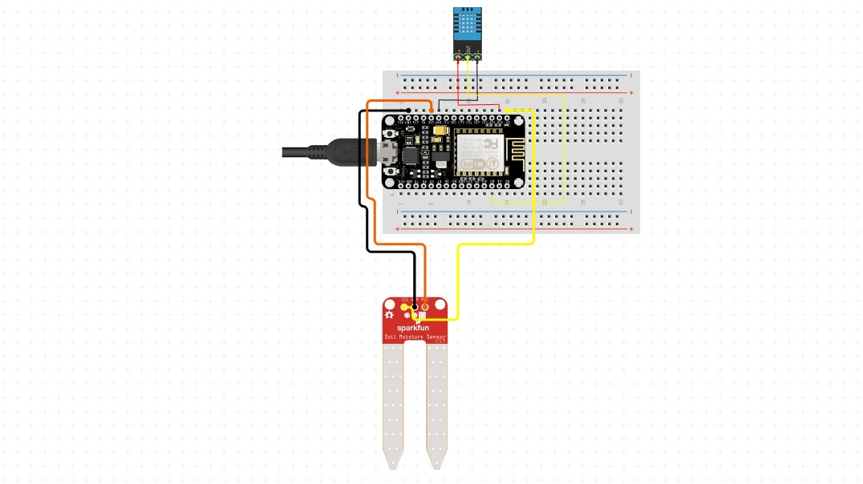
Circuit diagram

Slide 13
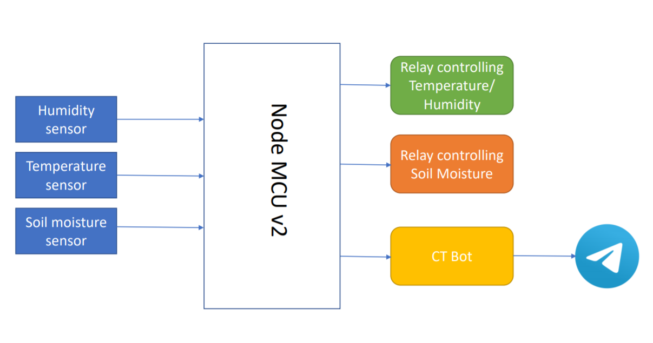
Working function

Slide 14
result
Thus the temperature, humidity and the soil moisture is monitored and controlled in the greenhouse monitoring system using IoT

Slide 15


THANK YOU
By
G S Sutharsan
: http://linkedin.com/in/sutharsan-gs
: sudharsansudhu30@gmail.com
R Abdul Rahim
: http://linkedin.com/in/abdulrahim-r
: sudharsansudhu30@gmail.com
M Praveen
: http://linkedin.com/in/praveen-m
: praveenmoon003@gmail.com

